Slide 1
HR ATTRITION
BY TEAM
TECH SARADHI

Slide 2
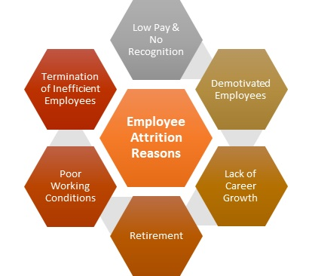
INTRODUCTION
Attrition refers to the phenomena of whether employees leaving the company or not.
Usually measured with a metric called Attrition rate
Attrition rate gives an idea as to how many employees leaving the company at any given time period.
Types of Attrition
Voluntary
Involuntary
Retirement
Reasons of Attrition

Slide 3
Objectives
To analyse the attrition rate.
To find out the reasons why attrition occurs.
To determine the solutions to avoid or to control attrition.
To understand the extent of job satisfaction among the employees.
Optimize staffing.

Slide 4
Data Collection(about the dataset)
HR Attrition dataset consists of 4411 rows and 24 columns.
Remove noisy and missing values.
Dependent variable (y) - Attrition
Independent variables(x) – education level, education, job role, job level, distance from home , gender, marital status , age.
As the given data is in strings, we used label encoder to convert categorical to numeric.

Slide 5
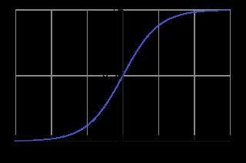
Why We Use Logistic Regression?
Choose the best regression algorithm which gives the more accuracy
The same accuracy is obtained for both random forest and logistic regression for the given dataset.
We can’t use the decision tree algorithm for large datasets as it makes the fitting complex.
Logistic regression gives 83% accuracy .
logistic sigmoid function:
It ranges from 0 to 1

Slide 6
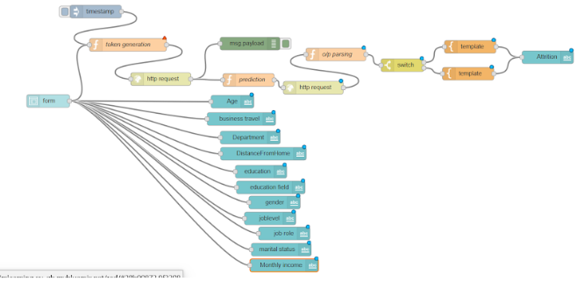
NODE-RED FLOW

Slide 7
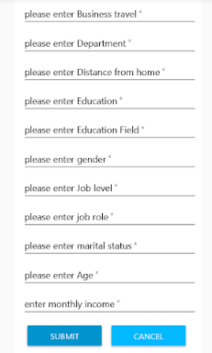
UI FORM

Slide 8
.
THANK YOU

